Slide 1
Spanning Forests and Shortest Path Algorithms

Slide 2
Spanning Forests
A forest may be defined as an acyclic graph in which every node has one or no predecessors.
A tree may be defined as a forest in which only a single node (called the root) has no predecessors.
Any forest consists of a collection of trees.
An ordered forest is one whose component trees are ordered.
Given a graph G, forest F is a spanning forest of G if
  F is a subgraph of G containing all the nodes of G.
  F is an ordered forest containing trees T₁, T₂, …,T_{n}.
  T_{i} contains all nodes that are reachable in G from the root of T_{i} and are not contained in T_{j} for some j < i.

Slide 3
Contd.
F is a spanning tree of G if it is a spanning forest of G and consists of a single tree.
Consider a graph G and its four spanning forests F₁, F₂, F₃ and F₄.
H
H
H
B
G
C
B
G
C
B
G
C
E
F
A
D
E
F
A
D
E
F
A
D
G
F₁
F₂
H
H
In the figure, F₁ & F₂ are spanning trees whereas those of F₃ & F₄ are not.
B
G
C
B
G
C
E
F
A
D
E
F
A
D
F₃
F₄

Slide 4
Spanning Trees
A spanning tree of an undirected graph is an undirected tree consisting of only those edges necessary to connect all the nodes in the original graph.
A spanning tree has the property that for every pair of nodes these exists only one path between them.
When determining the cost of a spanning tree of a weighted graph, the cost is simply the sum of the weights of the tree’s edges.
A minimal cost spanning tree is formed when the edges are picked to minimize the total cost.

Slide 5
Minimum Spanning Tree
It is a tree formed from graph edges that connects all the vertices of G at lowest cost
It exists if G is connected
It has only |V|-1 edges where |V| is the total number of vertices in G
It is tree because it is acyclic
It is spanning because it covers every vertex.
It is useful in undirected graph

Slide 6
Kruskal’s Algorithm
Algorithm
Initialize the spanning tree T to contain all the vertices (say n) in the graph G but not edges.
At the beginning, each vertex will be in its own set. Create sets of T with one vertex per set.
Choose the edge e with lowest cost from graph G.
Check if both vertices from e are within the same set in T, for all such sets of T. If not, add the edge e to T, and replace the two sets that this edge connects with their union.
Delete the edge e from the graph G and repeat from step 3 until there are no more edges to add or until T contains n-1 edges.
While repeating, avoid the cycle.

Slide 7
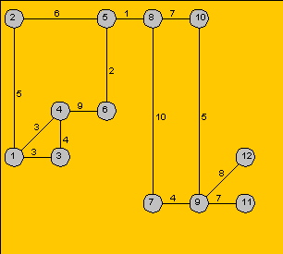
Ex-1 Find a minimum spanning tree from the following graph using Kruskal’s algorithm

Slide 8
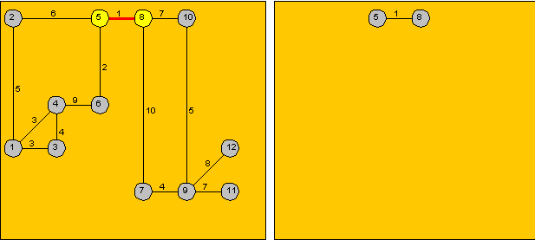
Step 1

Slide 9
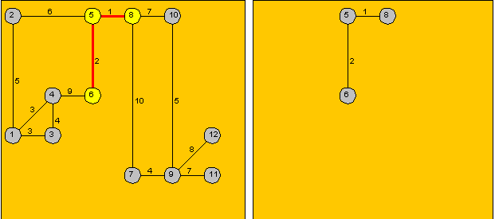
Step 2

Slide 10
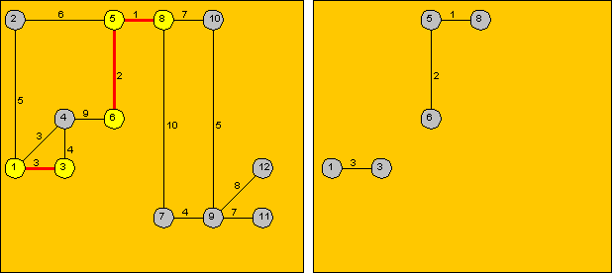
Step 3

Slide 11
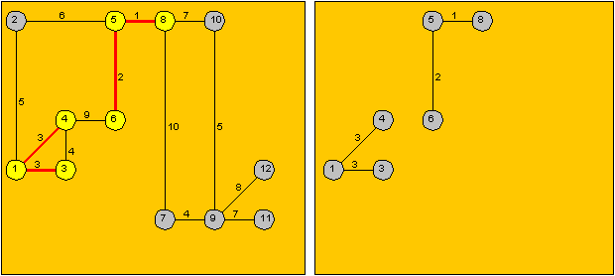
Step 4

Slide 12
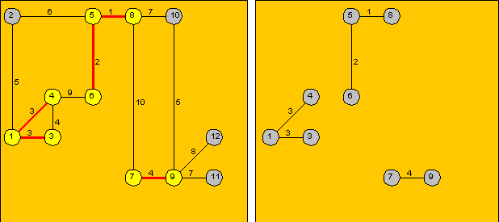
Step 5

Slide 13
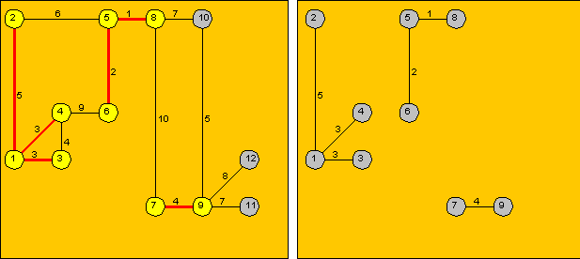
Step 6

Slide 14
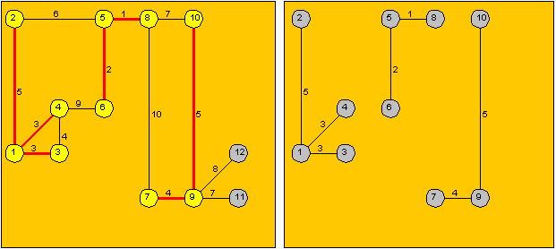
Step 7

Slide 15
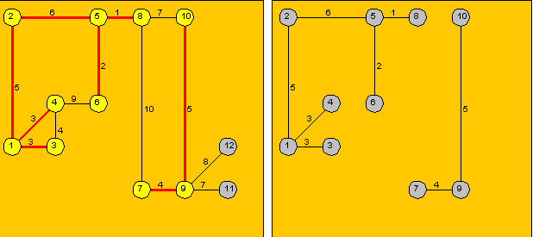
Step 8

Slide 16
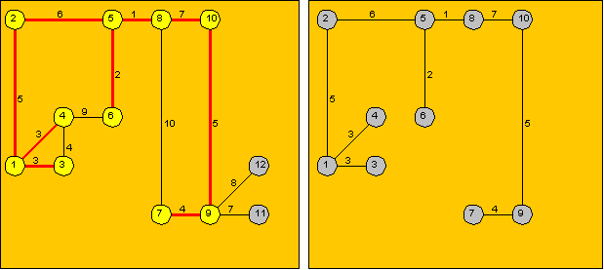
Step 9

Slide 17
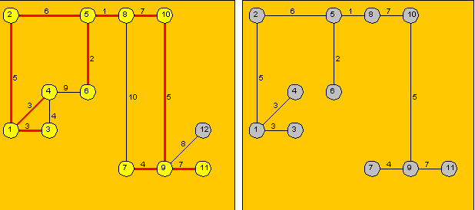
Step 10

Slide 18
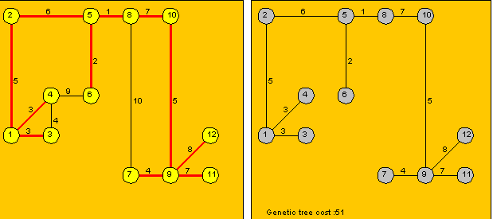
Step 11

Slide 19
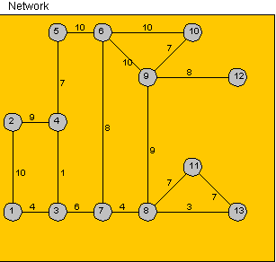
Ex-2 Find a minimum spanning tree from the following graph using Kruskal’s algorithm

Slide 20
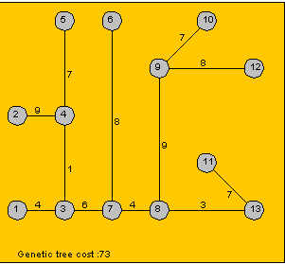
Solution

Slide 21
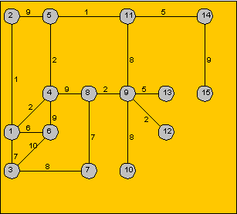
Ex-3 Find a minimum spanning tree from the following graph using Kruskal’s algorithm

Slide 22
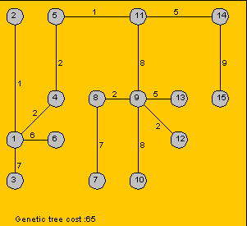
Solution

Slide 23
Shortest-Path Algorithms
Greedy Algorithm
The algorithm which seeks maximum gain at each step is called greedy algorithm.

Slide 24
Dijkstra’s Algorithm
Pronunciation – “Dike-stra”
It finds shortest paths in a weighted graph
Finding the shortest (least costly) path between two vertices, we start from source vertex to all other vertices in the graph.
This algorithm is a greedy algorithm as it seeks maximum gain at each step.

Slide 25
Algorithm
Choose the source vertex.
Define a set S of vertices and initialize it to contain only the source vertex. The set S will store those vertices to which a shortest path has been found.
Label each vertex not in S with the minimum distance from source vertex, but only if this vertex can be connected by a single edge with the source. (If there is no single edge connection between the source and the vertex not in S, label the vertex not in S with a distance of infinity.)
Add to S that vertex with a smallest distance as determined in step 3.

Slide 26
Contd.
5. Check the distances to all vertices not in S. If the latest addition to S in step 4 provides a single edge connection between a vertex in s and the vertex not in s, or a shorter path now exists, then adjust the distance to that vertex. Otherwise, do not change the distance.
6. Repeat the algorithm from step 4 until either all vertices are in the set S or all vertices not in S have an infinite distance to them. In the latter case, these vertices are not reachable from the source vertex at any cost.

Slide 27
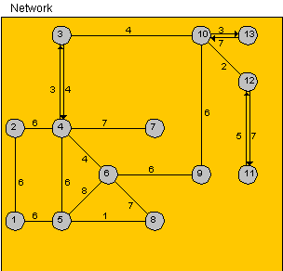
Ex-1 Find a shortest path from the following graph using Dijkstra’s algorithm

Slide 28
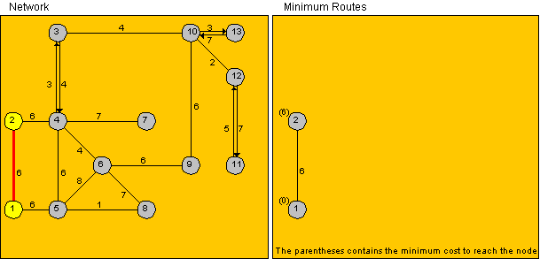
Step 1

Slide 29
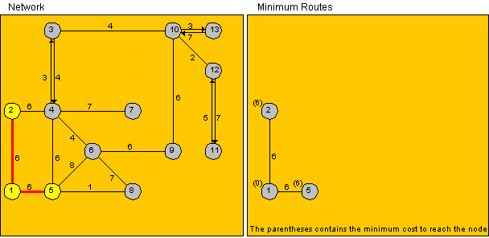
Step 2

Slide 30
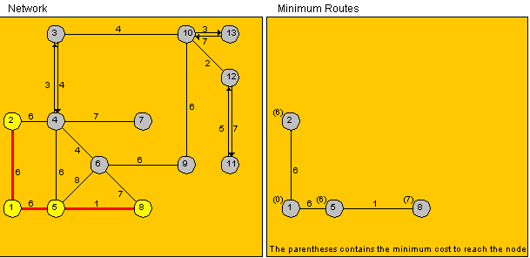
Step 3

Slide 31
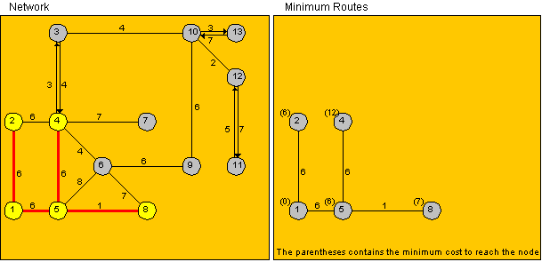
Step 4

Slide 32
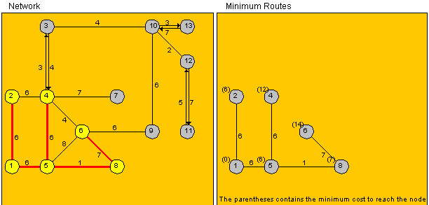
Step 5

Slide 33
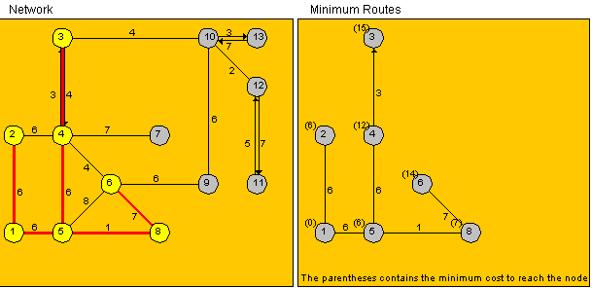
Step 6

Slide 34
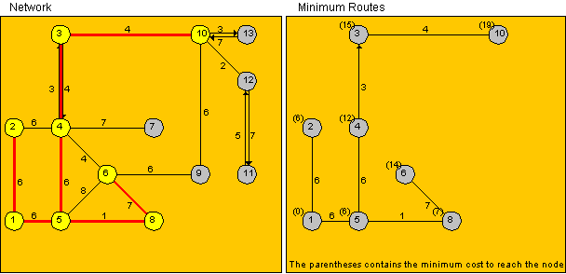
Step 7

Slide 35
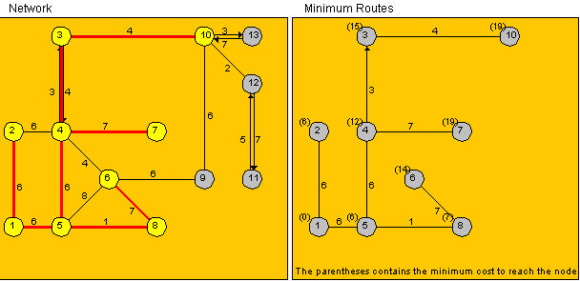
Step 8

Slide 36
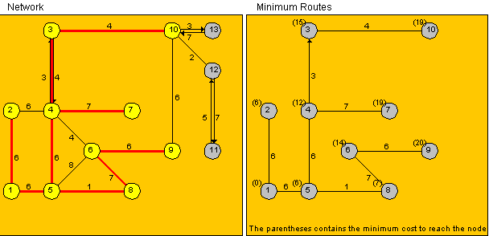
Step 9

Slide 37
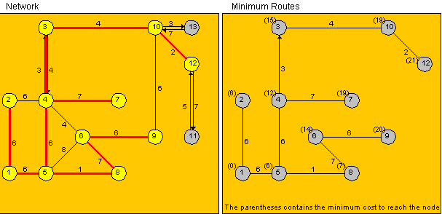
Step 10

Slide 38
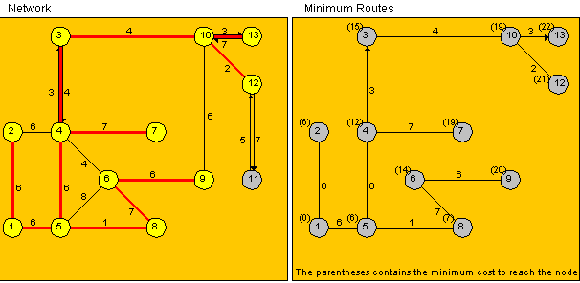
Step 11

Slide 39
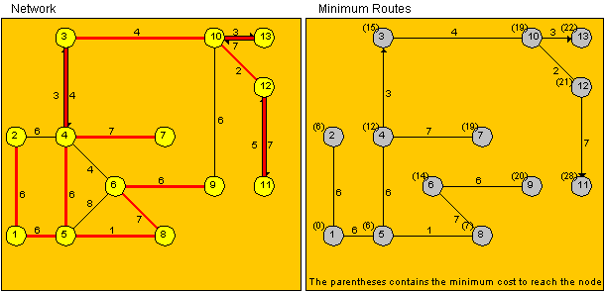
Step 12

Slide 40
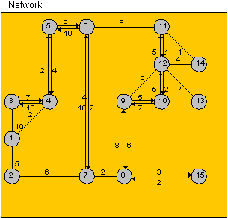
Ex-2 Find a shortest path from the following graph using Dijkstra’s algorithm

Slide 41
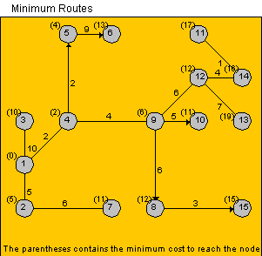
Solution

Slide 42
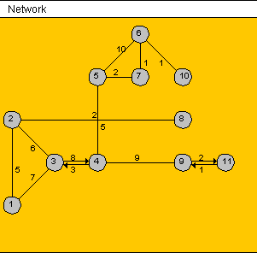
Ex-3 Find a shortest path from the following graph using Dijkstra’s algorithm

Slide 43
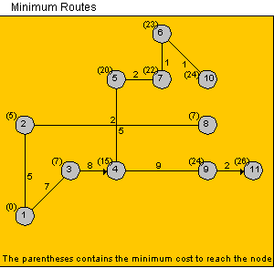
Solution

